Slide 1

Cyclistic Bike-Share
Prepared by: Joel Yap
Last Updated: July 26th, 2021

Slide 2
Table of Contents
Cyclistic Bike-Share
Purpose Statement (What are we talking about?)
Storytelling With Data
Conclusion (How to convert casual user to annual member?)
Appendix

Slide 3
What Are We Talking About?

Slide 4
First point
Objective
Identify the differences in average riding length, bike types preferences and average riding frequency between annual members and casual riders.

Slide 5
Data Presentation

Slide 6
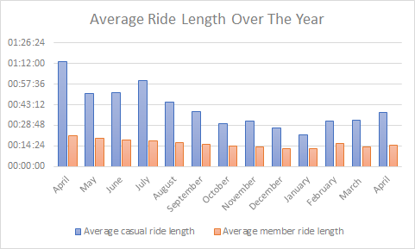
First point
Average Riding Length
Average riding length of casual user over the year has been observed to be around 40 minutes 55 seconds
Average riding length of annual member has been found to be 15 minutes 58 seconds
Casual riders use the bike drastically longer in time in comparison to annual members

Slide 7
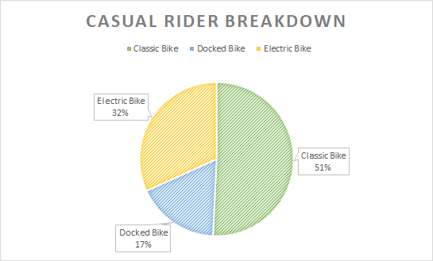
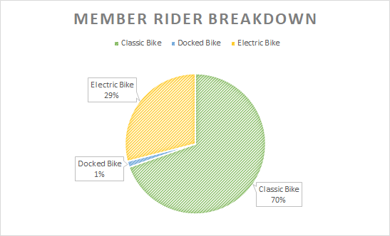
First point
Bike Types Preferences
According to the casual rider breakdown, 32% of them prefer using electric bike, 51% prefer using classic bike, and 17% prefer using docked bike
According to the member rider breakdown, 29% of them prefer using electric bike, 70% prefer using classic bike, and 1% prefer using docked bike
Classic bike demonstrated the highest popularity between both casual and annual rider, however member riders almost do not use docked bike

Slide 8
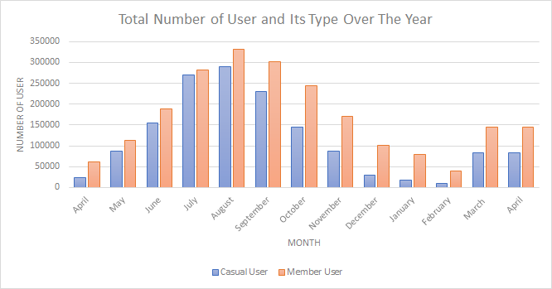
Average Riding Frequency
Year
Both casual and member rider depict similar riding trend over the year, highest usage is recorded on August
Overall, member rider showcases a higher usage compare to casual user over the year

Slide 9
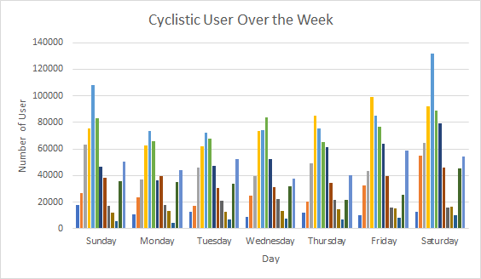
Average Riding Frequency
Week
Saturday has the highest usage rate from Cyclistic User, followed by Sunday over the course of the week
Cyclistic user often use the service during the weekend

Slide 10
Conclusion (How we could convert casual user to annual member?)

Slide 11
1
2
3
Annual members tend to ride the bike more frequently but in shorter riding length. Marketing strategy that is more valuable and worth it for users to use it over a long period of time should be launched.
More classic bike should be placed at each bike station with the reduction of docked bike as annual member prefer using classic bike a lot more.
More bikes should be provided during the weekend than weekday, as Cyclistic users often use the services during the weekend.

Slide 12
Thank You

Slide 13
First point
Appendix
All the data used to produce above findings are provided by Motivate International Inc with licensed
The dataset is reliable, original, comprehensive, current and cited
Data is being kept safely and stored in a secure file with only authorised accessibility

